Slide 1
Friday, September 16, 2016
Write In Your Agenda:
Write In Your Monitoring Log:
CW:
Finish Plotting the Evidence
Finish Picturing Life on Pangaea
HW:
Have Monitoring Log signed.
Finish Picturing Life on Pangaea (if not done already)
Response to Warm-Up:
Name and describe ONE type of evidence that Pangaea existed and that the Earth's surface changes over time.
You will need:
Pencil
Plotting the Evidence Sheets
Picturing Life on Pangaea

Slide 2
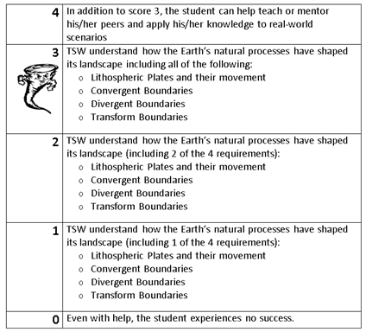
Learning Goal and Scale
TSW understand how the Earth’s natural processes have shaped its landscape (including Lithospheric Plates and their movement, Convergent, Divergent, and Transform boundary landforms).

Slide 3
https://www.youtube.com/watch?v=KCSJNBMOjJs

